Slide 1


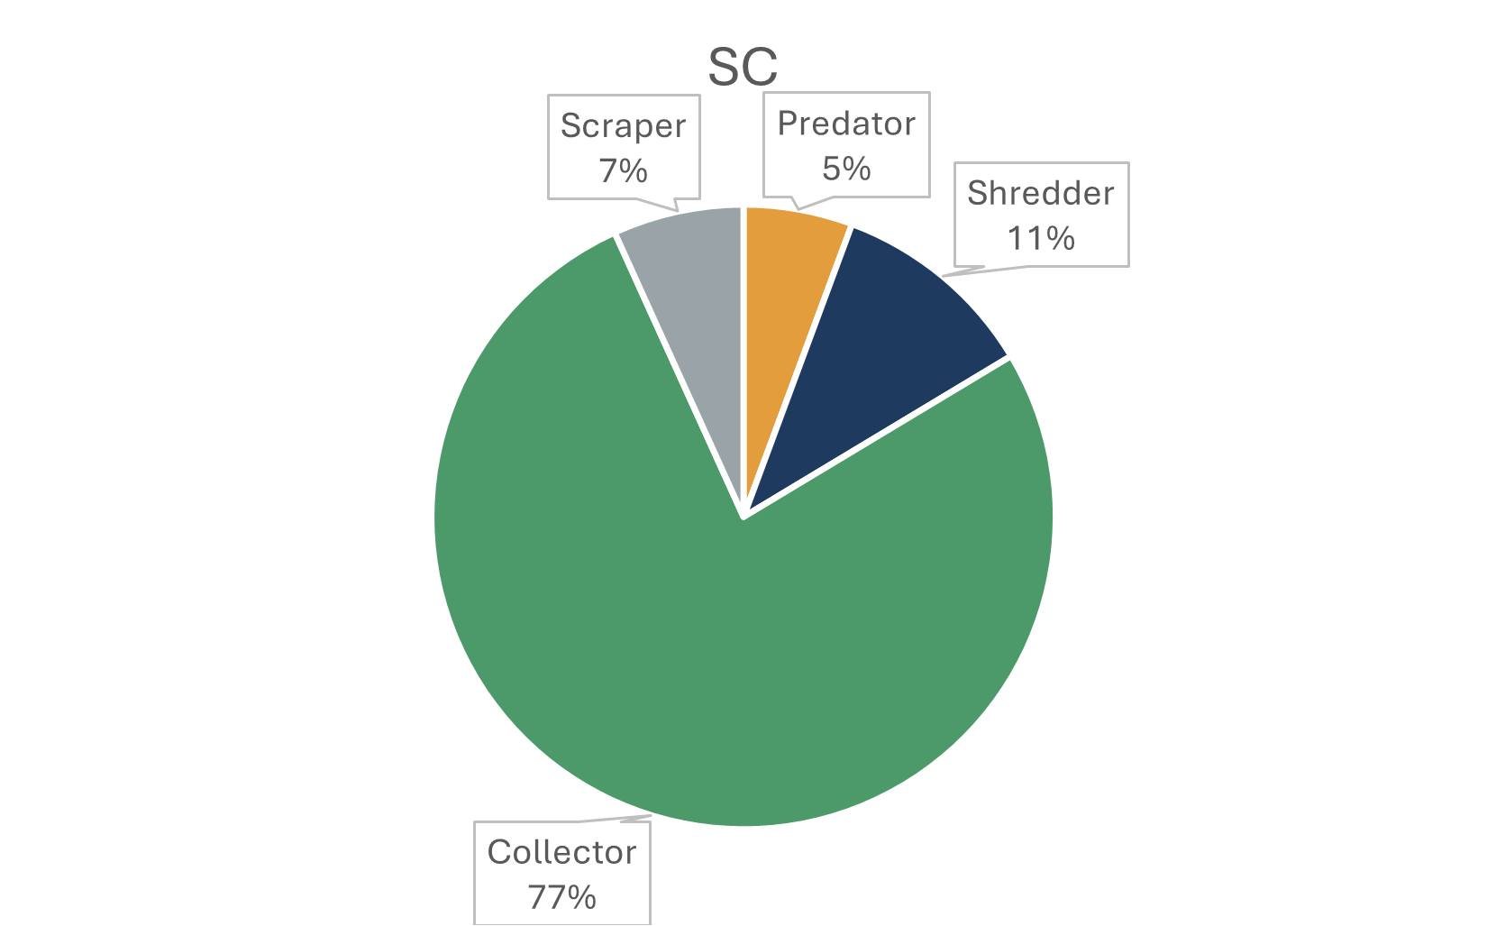
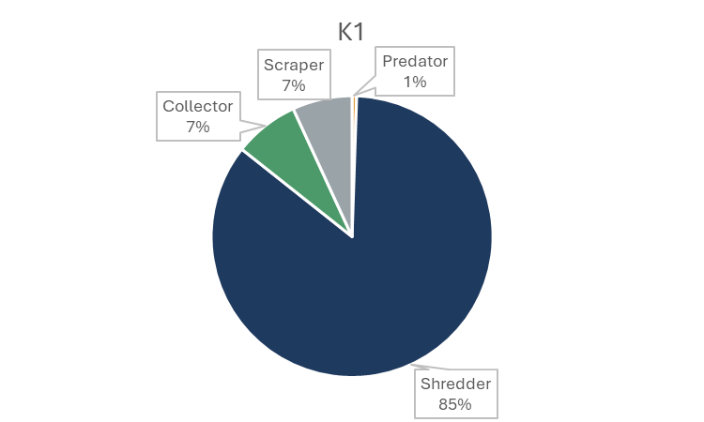
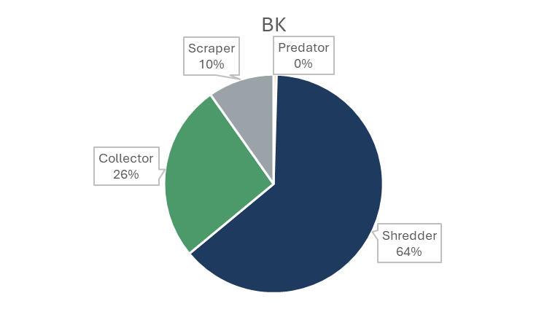
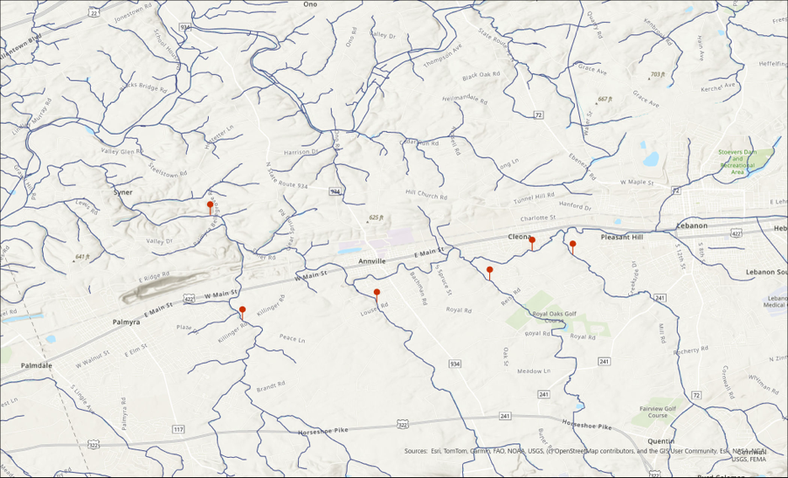

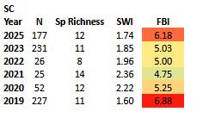
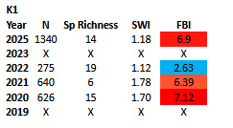
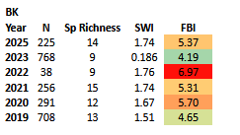
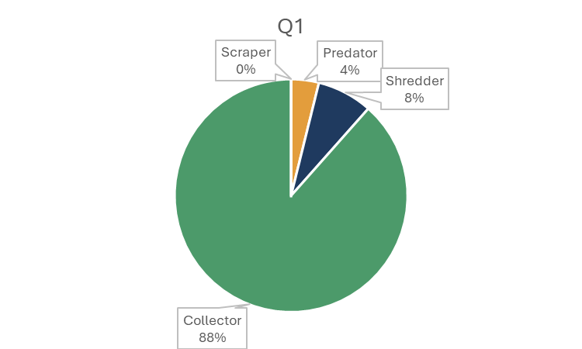
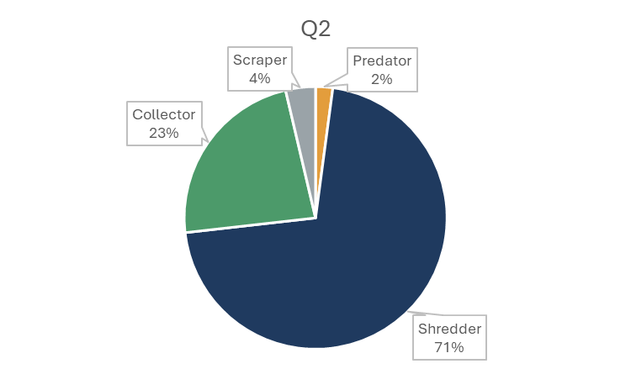
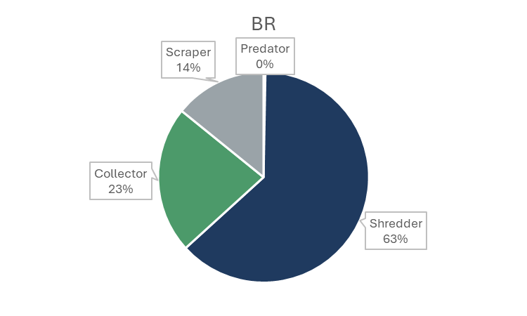
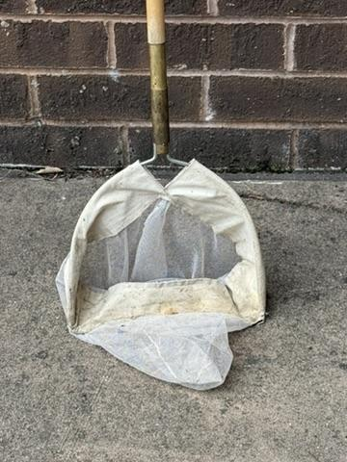
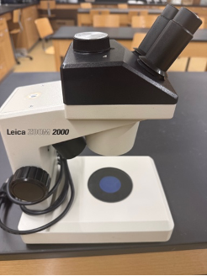
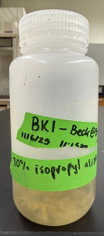
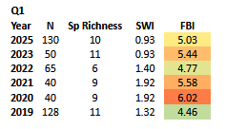
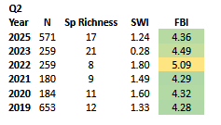
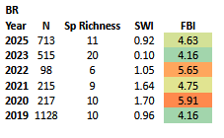

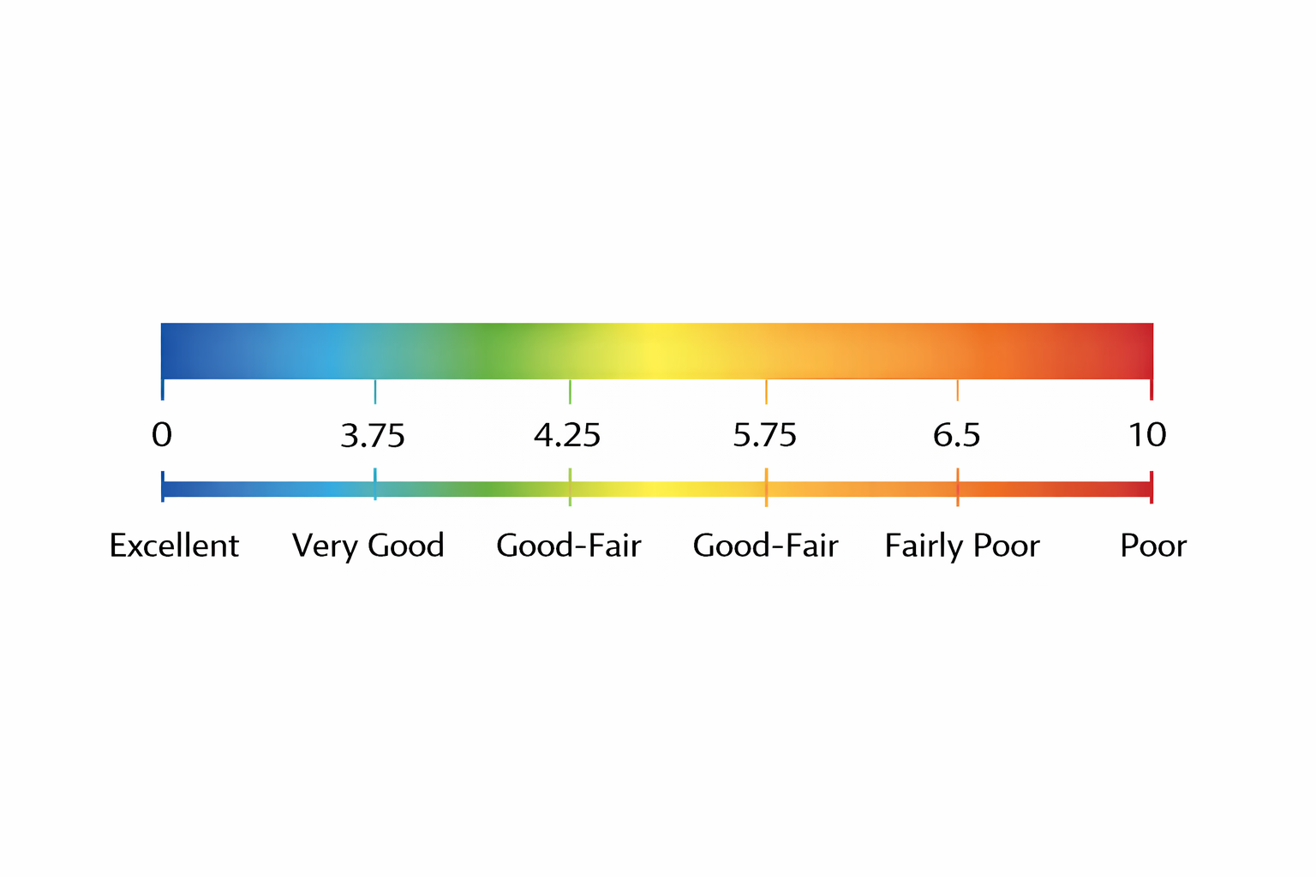
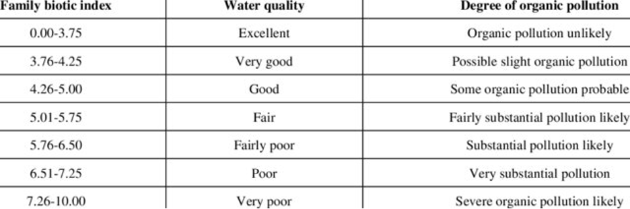

Using Macroinvertebrates as Bioindicators to Assess Water Pollution of the Quittapahilla Watershed
Branden Manderbach, Levi Wyszynski, Rebecca A. Urban
Department of Biology, Lebanon Valley College, 101 N College Ave, Annville, 17003
INTRODUCTION
Agricultural and urban runoff are two major sources of water pollution in Pennsylvania streams( Coulter et al ). In Lebanon County, the Quittapahilla watershed is comprised of 39.1% agriculture and 44.4% urban land use. (Quittie Watershed Alliance) These areas are potential sources of pesticides, heavy metals, microplastics, sediment, and nutrient pollution that can negatively impact water quality with detrimental effects on aquatic life. (Quittie Watershed Alliance) Benthic macroinvertebrates are often used as bioindicators to indirectly assess the condition of streams (Lukhabi et al). Streams with high water quality have a greater diversity of macroinvertebrates that are intolerant to water pollution. (Quittie Watershed Alliance) The Quittapahilla Watershed Association uses macroinvertebrates as part of their long-term monitoring program to document stream health.
OBJECTIVE
RESULTS
The objective of this project is to conduct a data analysis on the macroinvertebrate communities within six field sites of the Quittapahilla Watershed.
METHODS
N
Q2
Q1
K1
BM1
BK1
S1
Figure 1. This map shows the six water‑quality sampling locations across the Quittapahilla Creek watershed. Two sites lie on the mainstem—Quittapahilla Creek at Garfield Street (west) and Palmyra Bellegrove Road (downstream). Four tributary sites are also included: Snitz Creek at Dairy Road (south of Annville), Beck Creek at Bricker Lane (north of the main channel), Bachman Run at Louser Road (east of Annville), and Killinger Creek at Killinger Road near Cleona. Together, these locations capture conditions across both the main creek and its major tributaries.
Organization | Station | Station Name | Latitude | Longitude
QWA | Q1-macros | Quittapahilla Creek at Garfield Street | 40.332464 | -76.471849
QWA | Q2-macros | Quittapahilla Creek at Palmyra-Bellegrove Road | 40.342592 | -76.56349
QWA | S1-macros | Snitz Creek at Walnut Street | 40.331346 | -76.460273
QWA | BK1-macros | Beck Creek at Bricker Lane | 40.323999 | -76.483927
QWA | BM1-macros | Bachman Run at Louser Road | 40.317592 | -76.516046
QWA | K1-macros | Killinger Creek at Killinger Road | 40.312635 | -76.554315
D-nets were used to collect macroinvertebrates at each sampling site.
Dissecting Microscopes were used to ID macroinvertebrates to the family-level
Macroinvertebrates were preserved in 70% isopropyl alcohol
FBI = (∑n_{i} x t_{i})/ N
Water quality was indirectly calculated by the Family Biotic Index
n_{i} = number of individuals of species i
t_{i} = tolerance
N = total number of individuals across all species
Species diversity was calculated by the Shannon-Wiener Index
n_{i} = number of individuals of species i and N = total number of individuals.
DISCUSSIONS
– Macroinvertebrate composition varied across sites, indicating differences in water quality.
– Sites dominated by shredders (e.g., K1, BR) suggest high organic matter input, likely from runoff or riparian sources.
– Collector-dominated sites (e.g., Q1) may reflect increased fine organic particles and nutrient enrichment.
– Low predator abundance across sites indicates reduced trophic complexity and potential environmental stress.
– Sites with higher FBI values (more pollution-tolerant taxa) indicate poorer water quality, while lower FBI values suggest better conditions.
– Limited or absent scrapers may reflect reduced algal availability or substrate disturbance from sedimentation.
– Higher EPT presence indicates better water quality, as these taxa are sensitive to pollution.
– Overall, results suggest moderate impacts from agricultural and urban runoff across the watershed.
A interactive way to learn about the research.
REFERENCES
ACKNOWLEDGEMENTS
Quittie Watershed Alliance. QWA Monitoring Program. Quittie Watershed Alliance, Jan. 2026,
https://pawatersheds.org/wp-content/uploads/2026/01/QWA-Monitoring-Program_for-email.pdf. Accessed 20 Mar. 2026.
Coulter, Chris B., Randy K. Kolka, and James A. Thompson. “Water Quality in Agricultural, Urban, and Mixed Land Use Watersheds.” Journal of the American Water Resources Association, 2004, https://www.fs.usda.gov/nrs/pubs/jrnl/2004/nrs_2004_coulter_001.pdf
Lukhabi DK, Mensah PK, Asare NK, Akwetey MFA, Faseyi CA. Benthic macroinvertebrates as indicators of water quality: A case study of estuarine ecosystems along the coast of Ghana. Heliyon. 2024 Mar 13;10(7):e28018. doi: 10.1016/j.heliyon.2024.e28018. PMID: 38596140; PMCID: PMC11002552.
Thanks to the Quittapahilla Watershed Association for their work monitoring our local waterways.

